Slide 1

INTRODUCTION TO R
Danny Lumian, Ph.D.
Senior Data Scientist
Wednesday, June 28, 2023

Slide 2
About me
Ph.D. in Psychology from University of Denver (2018)
Galvanize data science bootcamp (2018)
Instructor @ Woz-U data science bootcamp (2021)
NIH contractor with ODSS as a Data Science Training Specialist (2022)
Senior Data Scientist at Daybreak LLC contracting with FDA (2023)
Started programming in Python in 2011
Experience with Python, R, MATLAB, SPSS, SQL, AFNI, SPM
Neuroimaging data (fMRI), skin conductance, eye-tracking, experiment design and more
Support free and open-source software (FOSS) like R and Python to create reproducible analysis and workflows

Slide 3
Overview
What is R
R platforms
R
Posit/R Studio
Posit Cloud/R Studio Cloud
R file types
Basic R commands
R packages and built-in datasets
Data manipulation
Data visualization
Data import and export
Data analysis
Each of the 6 lessons has a separate notebook.
We will not be able to cover all of them today.
All notebooks remain in the repository for future reference and self-review.

Slide 4
Tips and Tricks
R programming has much in common with other programming languages such as Python
Each has unique packages but often similar functionality
Packages are essential to getting the most out of your effort
Documentation-Check it and write it!
Error messages are designed to help with debugging
There are MANY helpful resources available
Improve your skills
Solve issues (StackOverflow)

Slide 5
Tech Stack/Programming Ecosystem
R allows for many common data operations, however, to be a complete programmer often requires additional skillsets
Below are common skillsets that enhance your ability to do your work as a researcher, developer or data scientist
Version Control: GitHub, GitLab
Database: SQL
Environments: Allows others to replicate and use your scripts
Remote compute and cloud services: Vital skill when data is too large for your personal workstation
Dashboards: R Shiny, Tableau

Slide 6
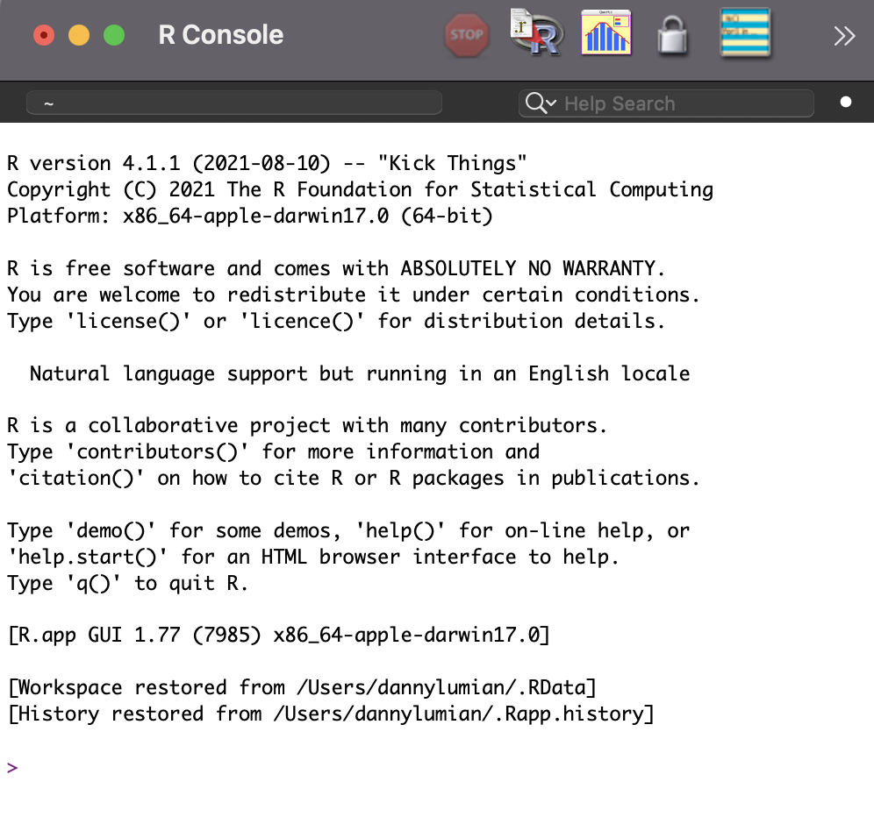
What is R?
An open-source programming language and software environment that can:
Manipulate data
Visualize data
Perform statistics
Free and relatively easy to run in any environment (Unix, Windows, & MacOS)
Recently changed to Posit
https://www.r-project.org/

Slide 7

Why R?
With FOSS, it is easy to get analysis tools, share and collaborate on work with few barriers to access
Compared with MATLAB, which requires licensing
Use of programming language is typically required for big data
Excel can not handle millions of datapoints
R is currently considered the standard for bioinformatics and biostatistics with many packages for advanced visualization and analysis
Bioconductor
Tidyverse

Slide 8
What is R Studio?
An integrated development environment (IDE) for R
Software that includes R, R console, file explorer, graphics viewer, code notebook and more!
One stop shop for coding in R
https://posit.co/

Slide 9
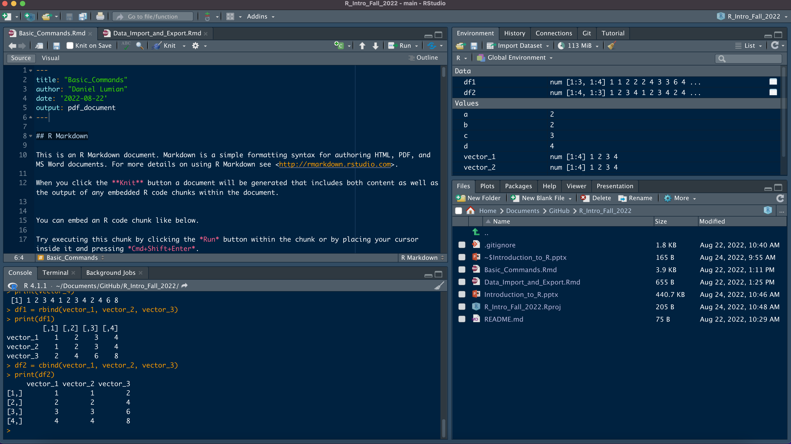
Notes:
4 main panes:
Top left-Script and notebook viewer
Top right-Environment. Variables and history
Bottom Left-Console/Terminal
Bottom right-file explorer, graphics pane, packages and help

Slide 10
What is Posit Cloud?
Cloud based version of R Studio
No need to download software
Can share projects easily for analysis and teaching
Allows for pre-installation of required packages
https://posit.cloud/
Recommended platform if you have not used R/R Studio before
Not recommended for larger projects due to limitation on resources

Slide 11
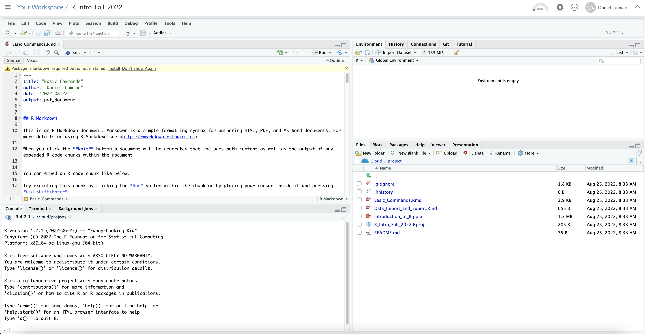
Notes:
Notice identical layout as R Studio

Slide 12
R File Types
R Script File
R Markdown and Notebook
Basic file for saving code
Can add comments using `#` symbol
Documenting code with comments is a best practice
Useful for testing code snippets and work that will not be shared
Sections can be selected and run
More advanced files that allow inclusion of markdown and style elements for documentation
Code lives in chunks within the file
Better for sharing and publishing code
Notebooks allow a preview feature, while Markdown files are knit
https://stackoverflow.com/questions/43820483/difference-between-r-markdown-and-r-notebook

Slide 13
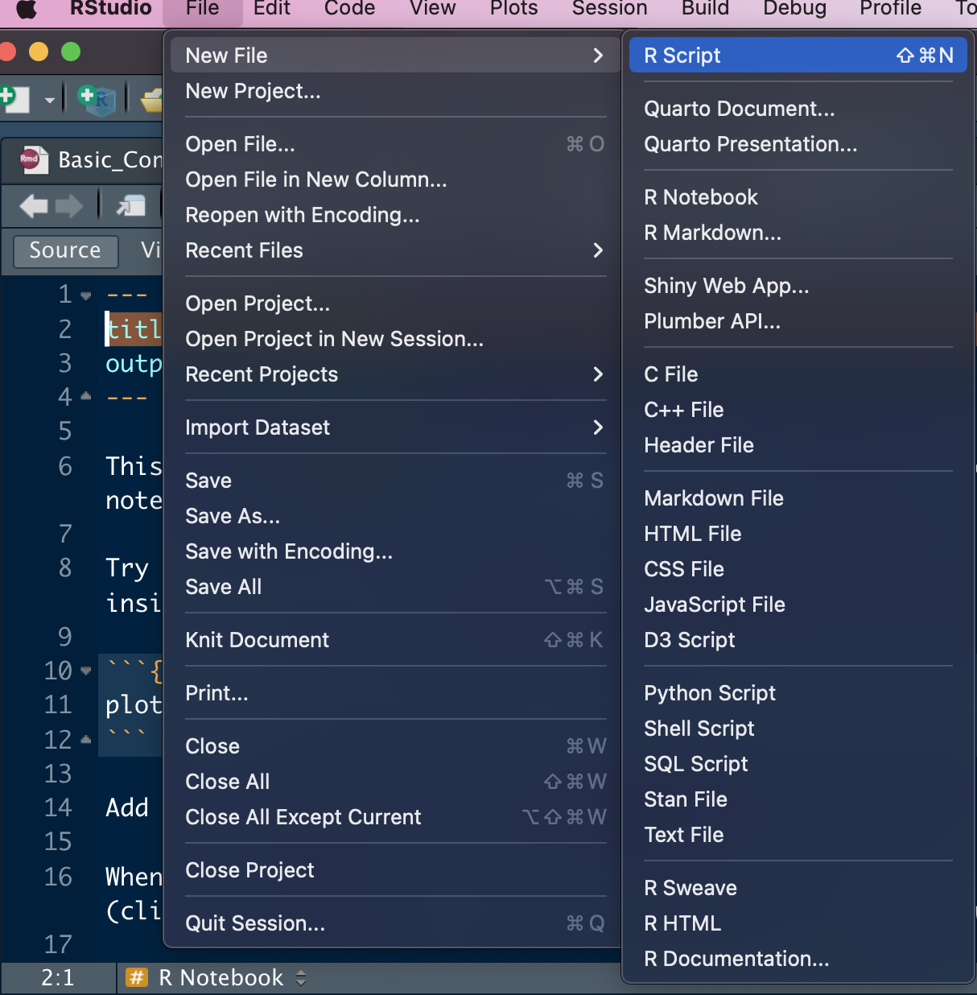
Open a new file
Select File from the top panel
Select New File from the dropdown
Select appropriate file type
R script
R Notebook
R Markdown
Open an existing file
Select File from the top panel
Select Open File
Select the file you wish to open
Save a file
Select File from the top panel
Select Save or Save as
Specify the save location
Notes:
Notice identical layout as R Studio

Slide 14
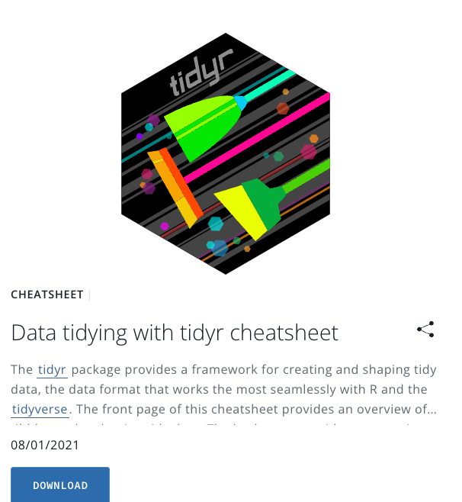
R and R Studio Cheat Sheets
Cheat Sheets
There are many capabilities, packages and tools available in R which can not be covered in a single session
This resource has helpful guides to some of the most popular packages and common uses of these packages

Slide 15
Let’s get started!
R Studio Cloud
Local R Studio
Log in or sign up for Posit Cloud
Go to: https://posit.cloud/
Open the following project
https://posit.cloud/content/6136578
Click on Save a permanent copy
Click on the new file icon
Select R script
Clone GitHub repo
https://github.com/dlumian/NIH-R-Introduction
Navigate to repo directory
Open NIH-R-Introduction.Rproj file with RStudio
Click on the new file icon
Select R script

Slide 16
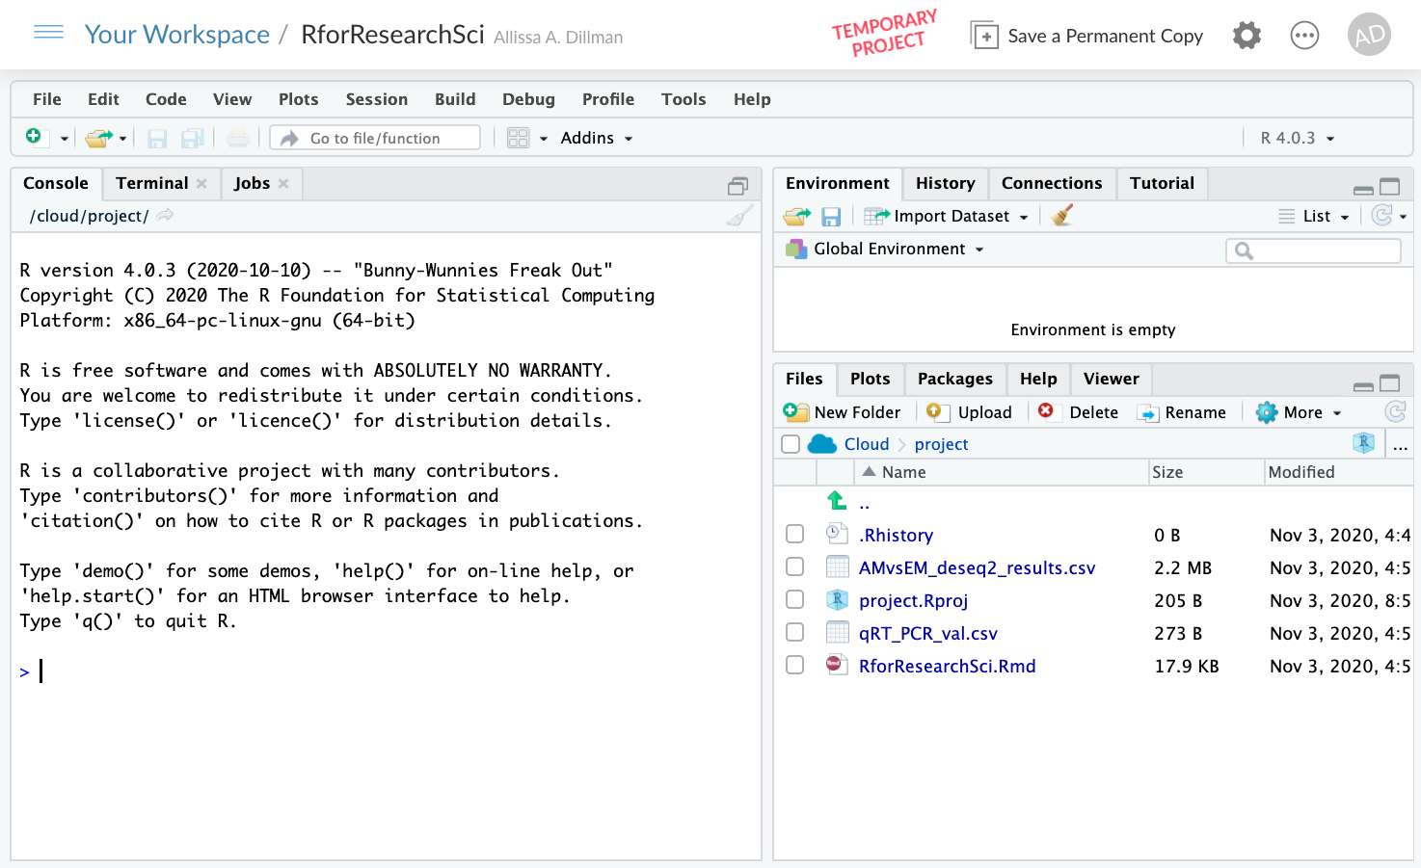
Notes:
Make slide for uploading data

Slide 17
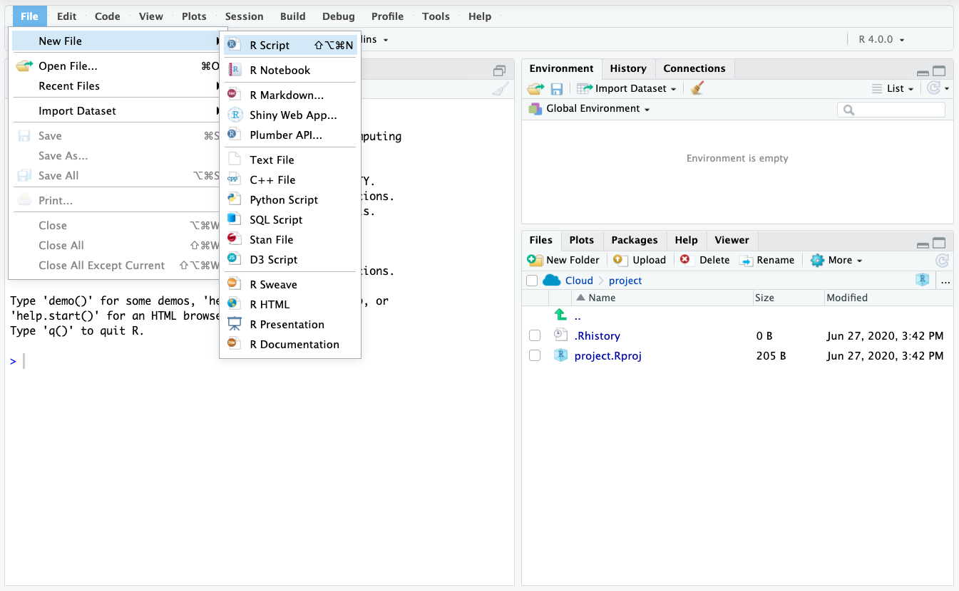
Write code here
Objects go here
Run code here
Written files go here
Notes:
Talk about the various windows console versus script file ect…

Slide 18
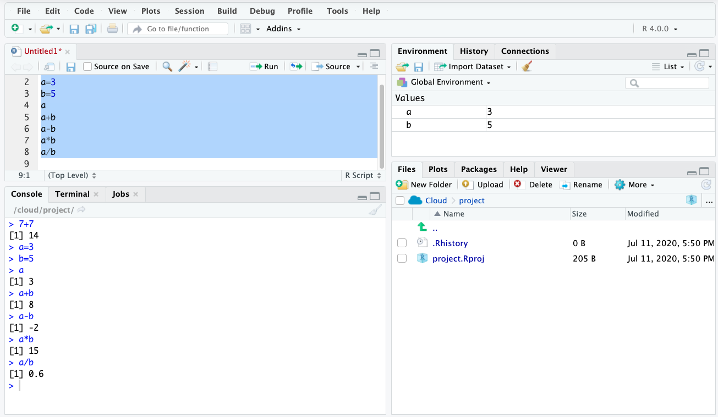
Highlight the section of code you want to run then click run
Temp memory objects
Notes:
Point out two ways to run: console and script

Slide 19
Basic R Arithmetic Operations
Basic addition: 7 + 7
Assign variables:
a=3
b=5
See contents of a variable:
Typing “a” returns “3”
Typing “b” returns “5”
Run operations on variables:
a+b
a-b
a*b
a/b
Two ways to run these operations:
Enter each line in the console and push enter
Enter all lines into the script, select which lines to run and push run
Notes:
We are running all these commands in the script file if we make a mistake we can edit and rerun. We can also make comments using # and it will not get in the way of the code.

Slide 20
Highlight the section of code you want to run then click run
Temp memory objects

Slide 21
Vectors and Functions
Vectors are a data structure in R
must be same data type
list of characters
list of numbers
Use the ”c” function to combine items
c(5,6,7,8) creates a vector
c stands for combine
Putting a `?` before a command or object will retrieve the help for that object
Type : ?c
Notes:
C is short for combine

Slide 22
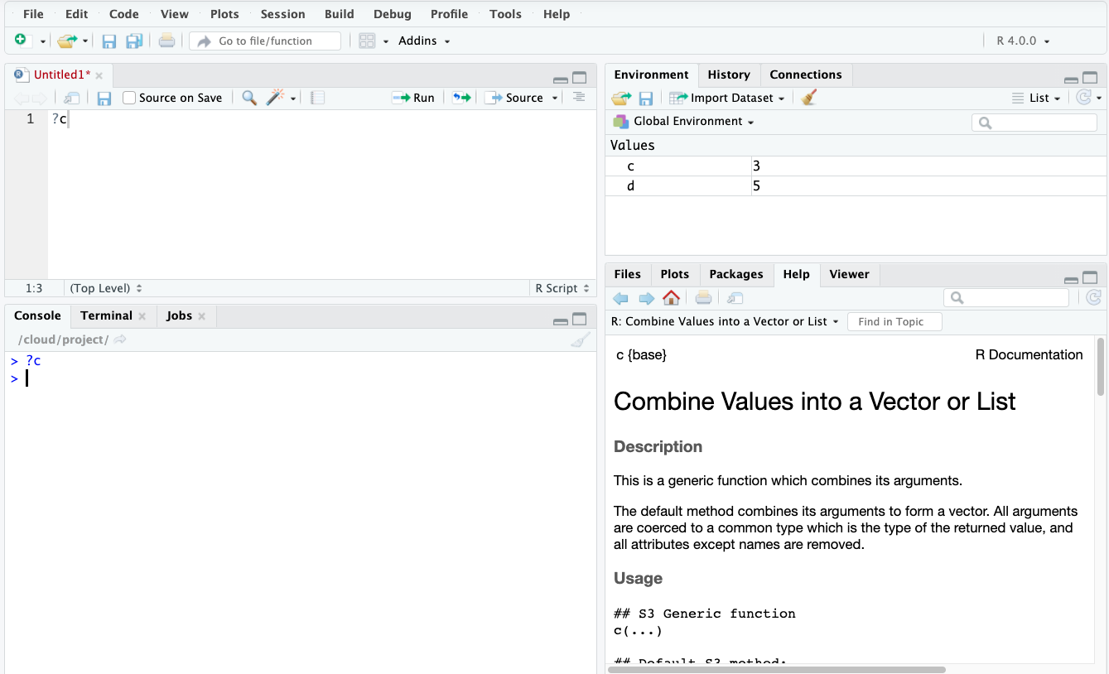

Slide 23
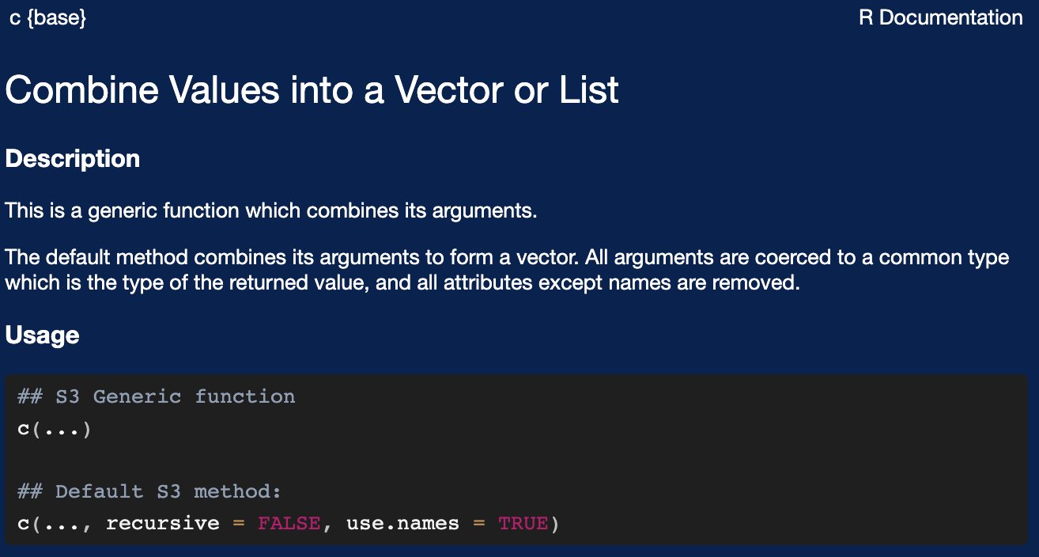
Help Details
Typing “?” then the command name will give you help on the command name
Typically, examples you can try may be available at the bottom of the help information

Slide 24
Create an object
Running c(5,6,7,8) will only return the output to console
To store objects in R memory assign a variable name
This allows for reuse of the variable
Type "d <-" in front of c(5,6,7,8) : d <- c(5,6,7,8)
This creates an R object called “d” that is a vector of 5,6,7,8
Keyboard shortcut for <-
-PC: Alt and - at the same time
-Mac: option and - at the same time
Notes:
https://support.rstudio.com/hc/en-us/articles/200711853-Keyboard-Shortcuts

Slide 25
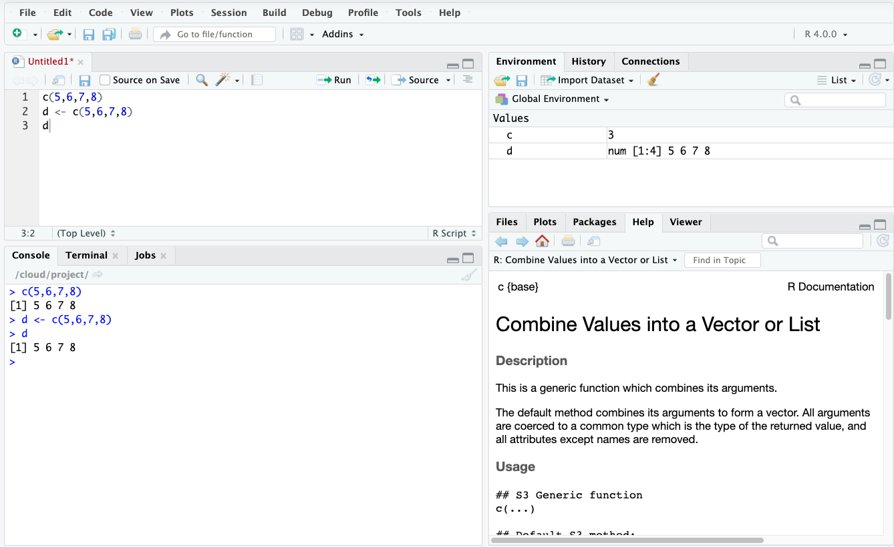

Slide 26
Make more vectors
e <- c(11,12,13,15)
f <- c(1,2,3,4)
g <- c(1,2,3,15)

Slide 27
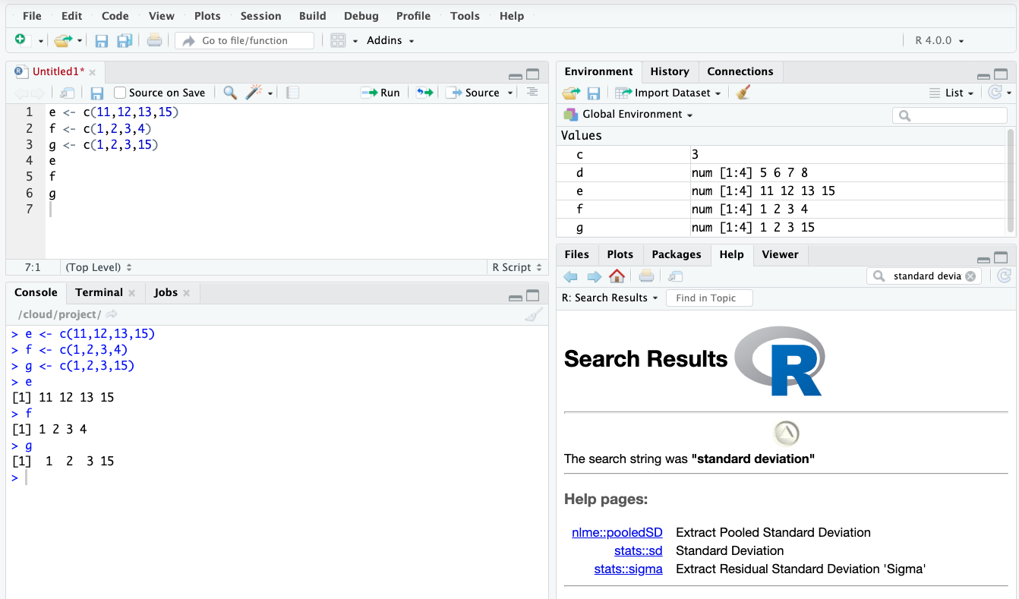

Slide 28
Perform Vector Calculations
d+e
d*e
f-g
f/g

Slide 29
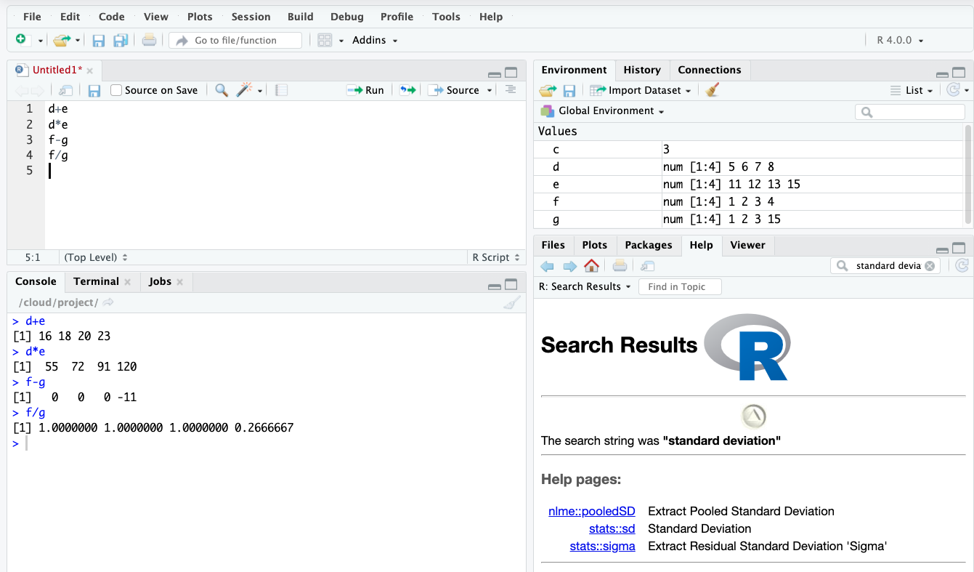

Slide 30
Combine Vectors
h <-c(d,e)
h <-rbind(d,e)
h <-cbind(d,e)
Not sure how c will combine vectors?
Run the example and see!
Not sure what rbind and cbind do?
Check their help documentation!

Slide 31
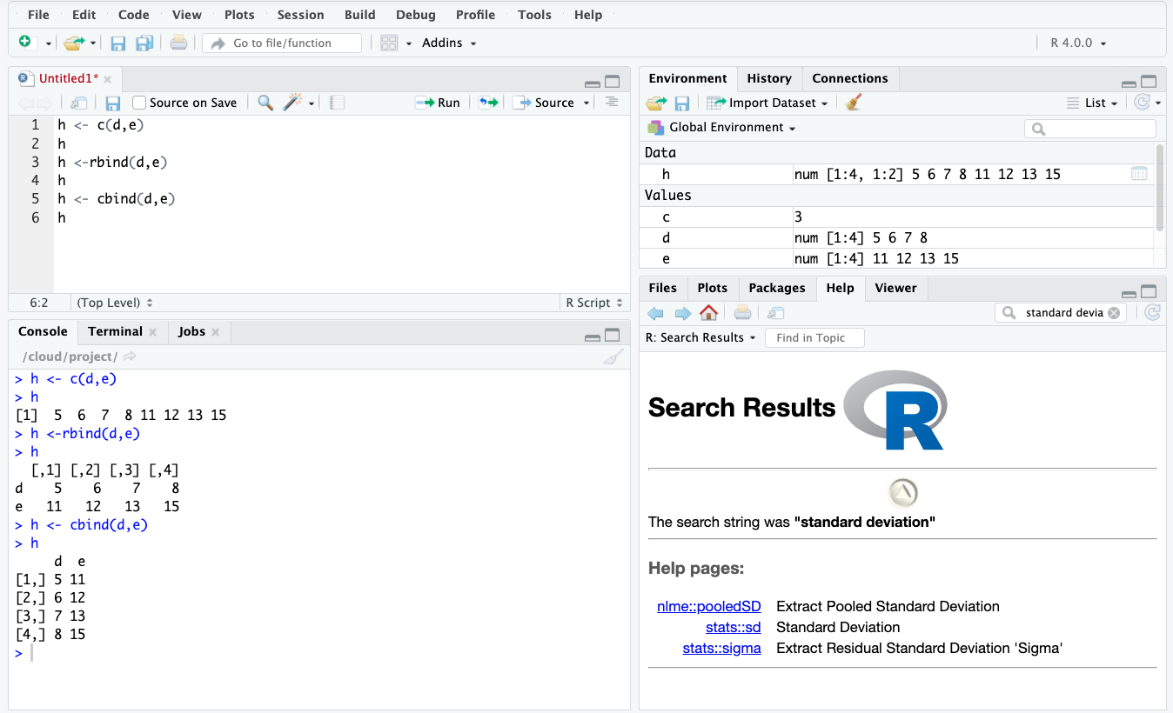

Slide 32
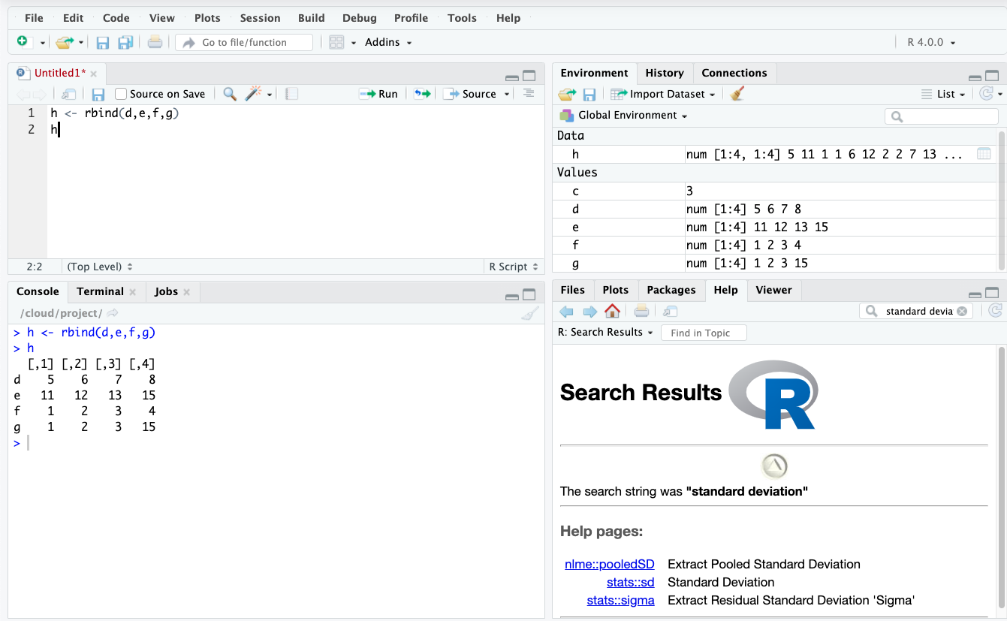
Let's Make a Data Table!
h <- rbind(d,e,f,g)

Slide 33
Colnames and Row names
Independent of the data
Makes it easier to work with data later
?colnames
?rownames
Type the following:
colnames(h) <- c("Col1","Col2","Col3","Col4")
rownames(h) <- c("Row1","Row2","Row3","Row4")

Slide 34
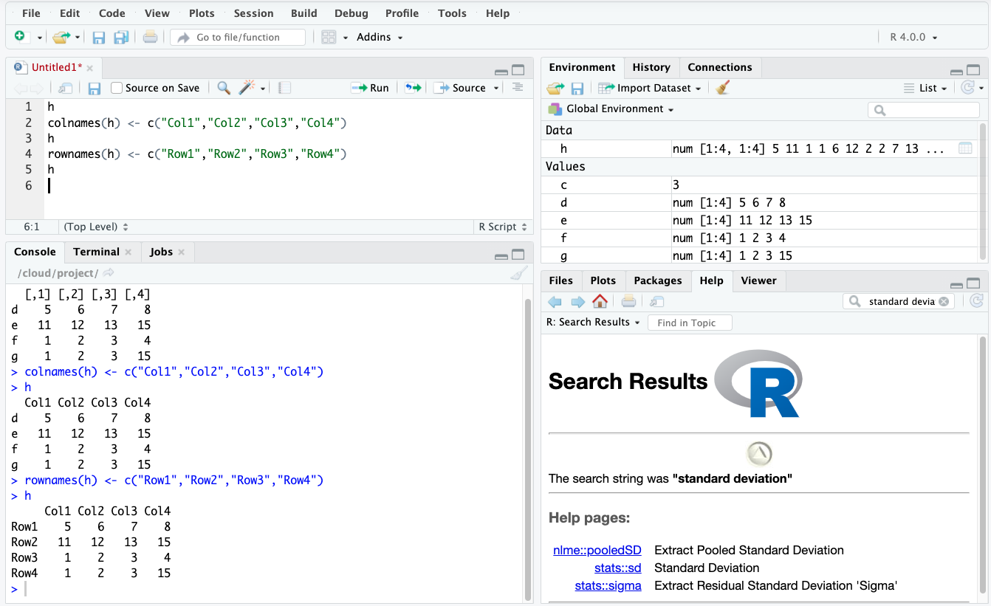

Slide 35
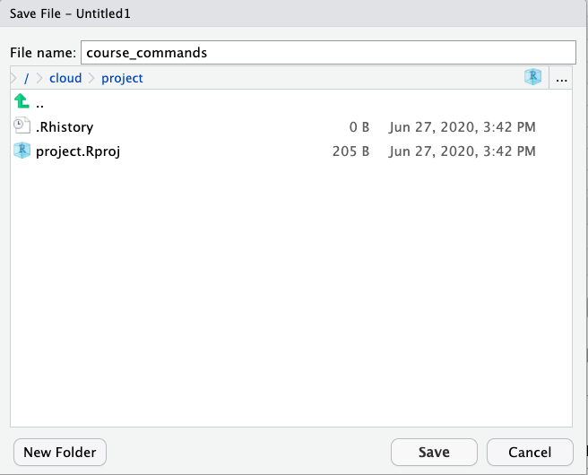
Save your amazing work!

Slide 36
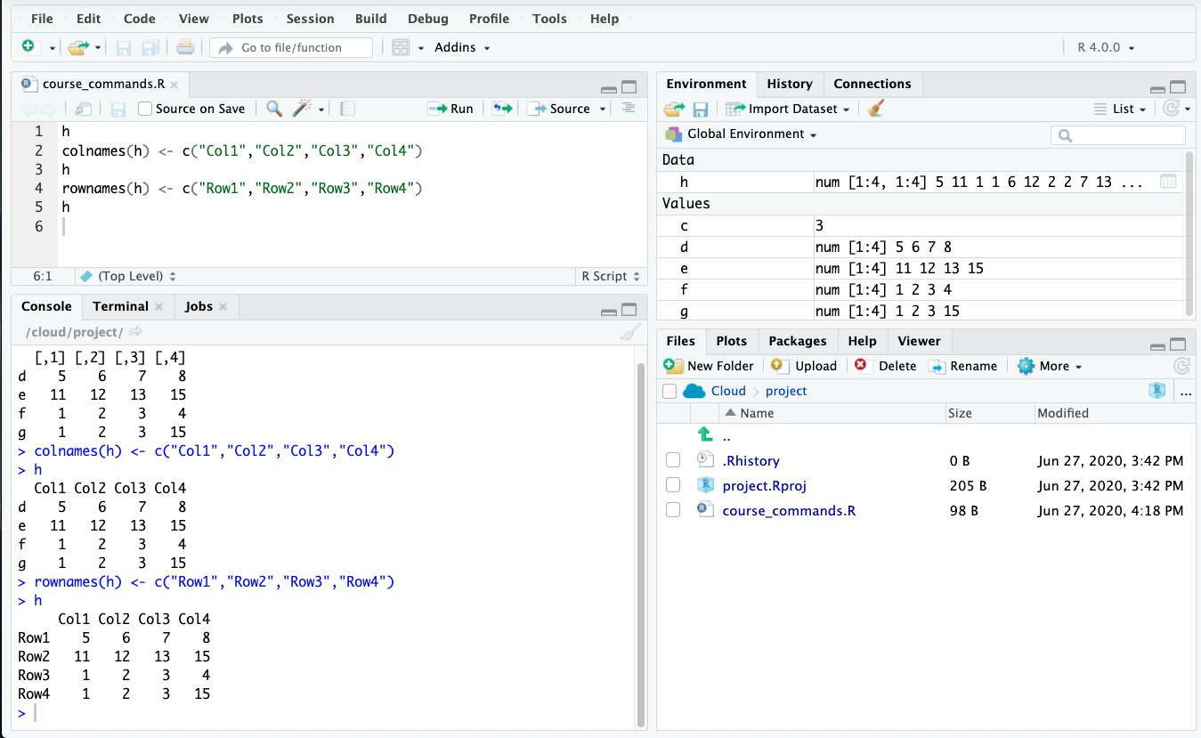

Slide 37
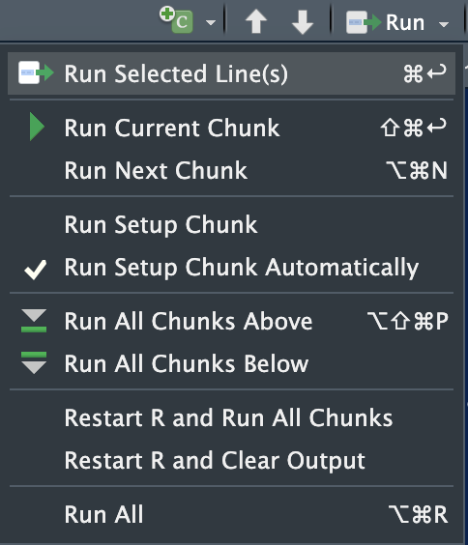
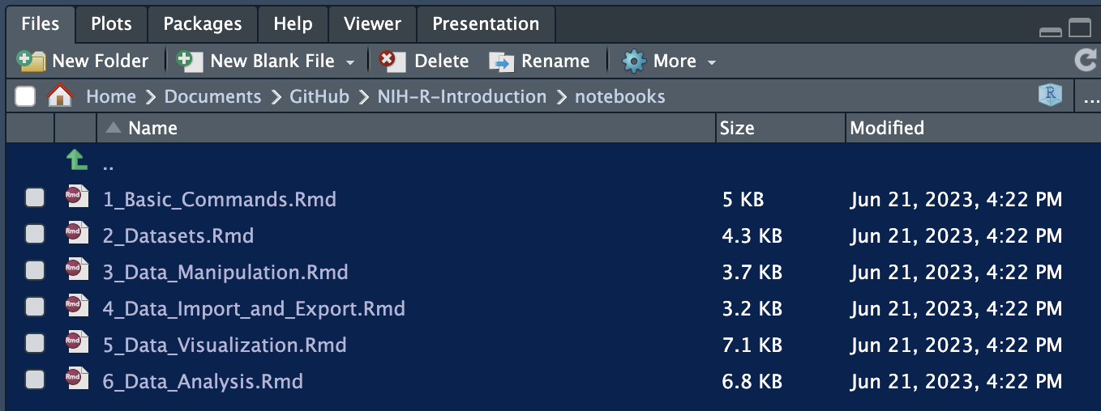
Activity 1: 1_Basic_Commands.Rmd
We just learned about creating R scripts to manipulate basic data (vectors, data frames)
Run 1_Basic_Command.Rmd notebook to reinforce your skills and learn about running R Markdown
Please let me know if you run into any issues or have any questions

Slide 38
Questions?
Recap
Accessed R via R Studio or R Studio Cloud
Created a script
Done basic math operations
Created and used vectors
Done vector math
Created a data frame with named rows and cols
Ran a markdown notebook reinforcing these concepts
Up next:
R Built-In Datasets

Slide 39
Datasets
In the previous section, we created datasets by inputting and combining vectors
It is more common to import existing data
R has functionality to import many kinds of data
Tabular data like csv, excel and text delimited files
Outputs from other analysis packages (e.g., SPSS, Stata)
Images and other complex data formats
Specific packages for importing bioinformatics data

Slide 40
Built-in Datasets
Datasets can be imported to or exported from R,
R and some packages also include built-in datasets
Built-in datasets are helpful for learning about data wrangling and testing functionality
Do not require complex imports
Often have example analysis and results for comparison

Slide 41
New Operations
data(): shows available datasets
summary(df): summary data for all cols in dataframe
$: df$column will return the column specified for that dataframe
Basic plots: hist, boxplot and scatterplot

Slide 42
Activity 2: Built-in Datasets
Open 2_Datasets.Rmd file
This file explores working with built-in datasets and base R plotting
We will work with the Iris dataset from Base R

Slide 43
Data Manipulation
Use base R functions
Use the tidyverse collection of packages
Specifically designed for data science

Slide 44
What is a package?
A collection of R functions, complied code and data
Saved in a directory called “library”
Can be turned on and off
Made by different people so commands may clash
Would be very slow to load everything every time, so load only what you need

Slide 45
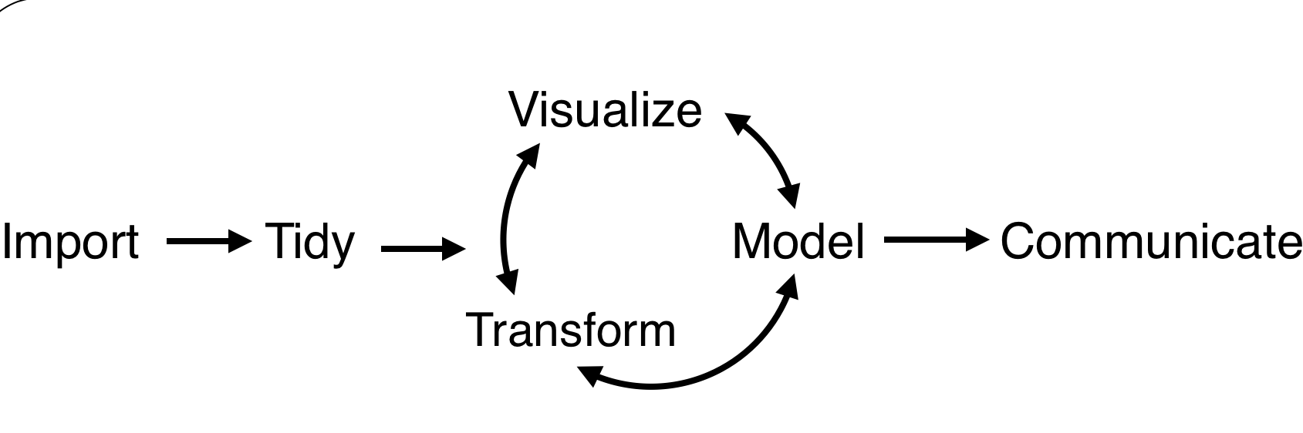
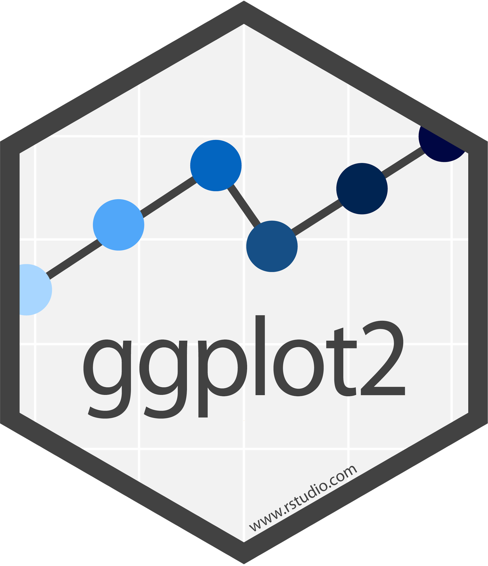

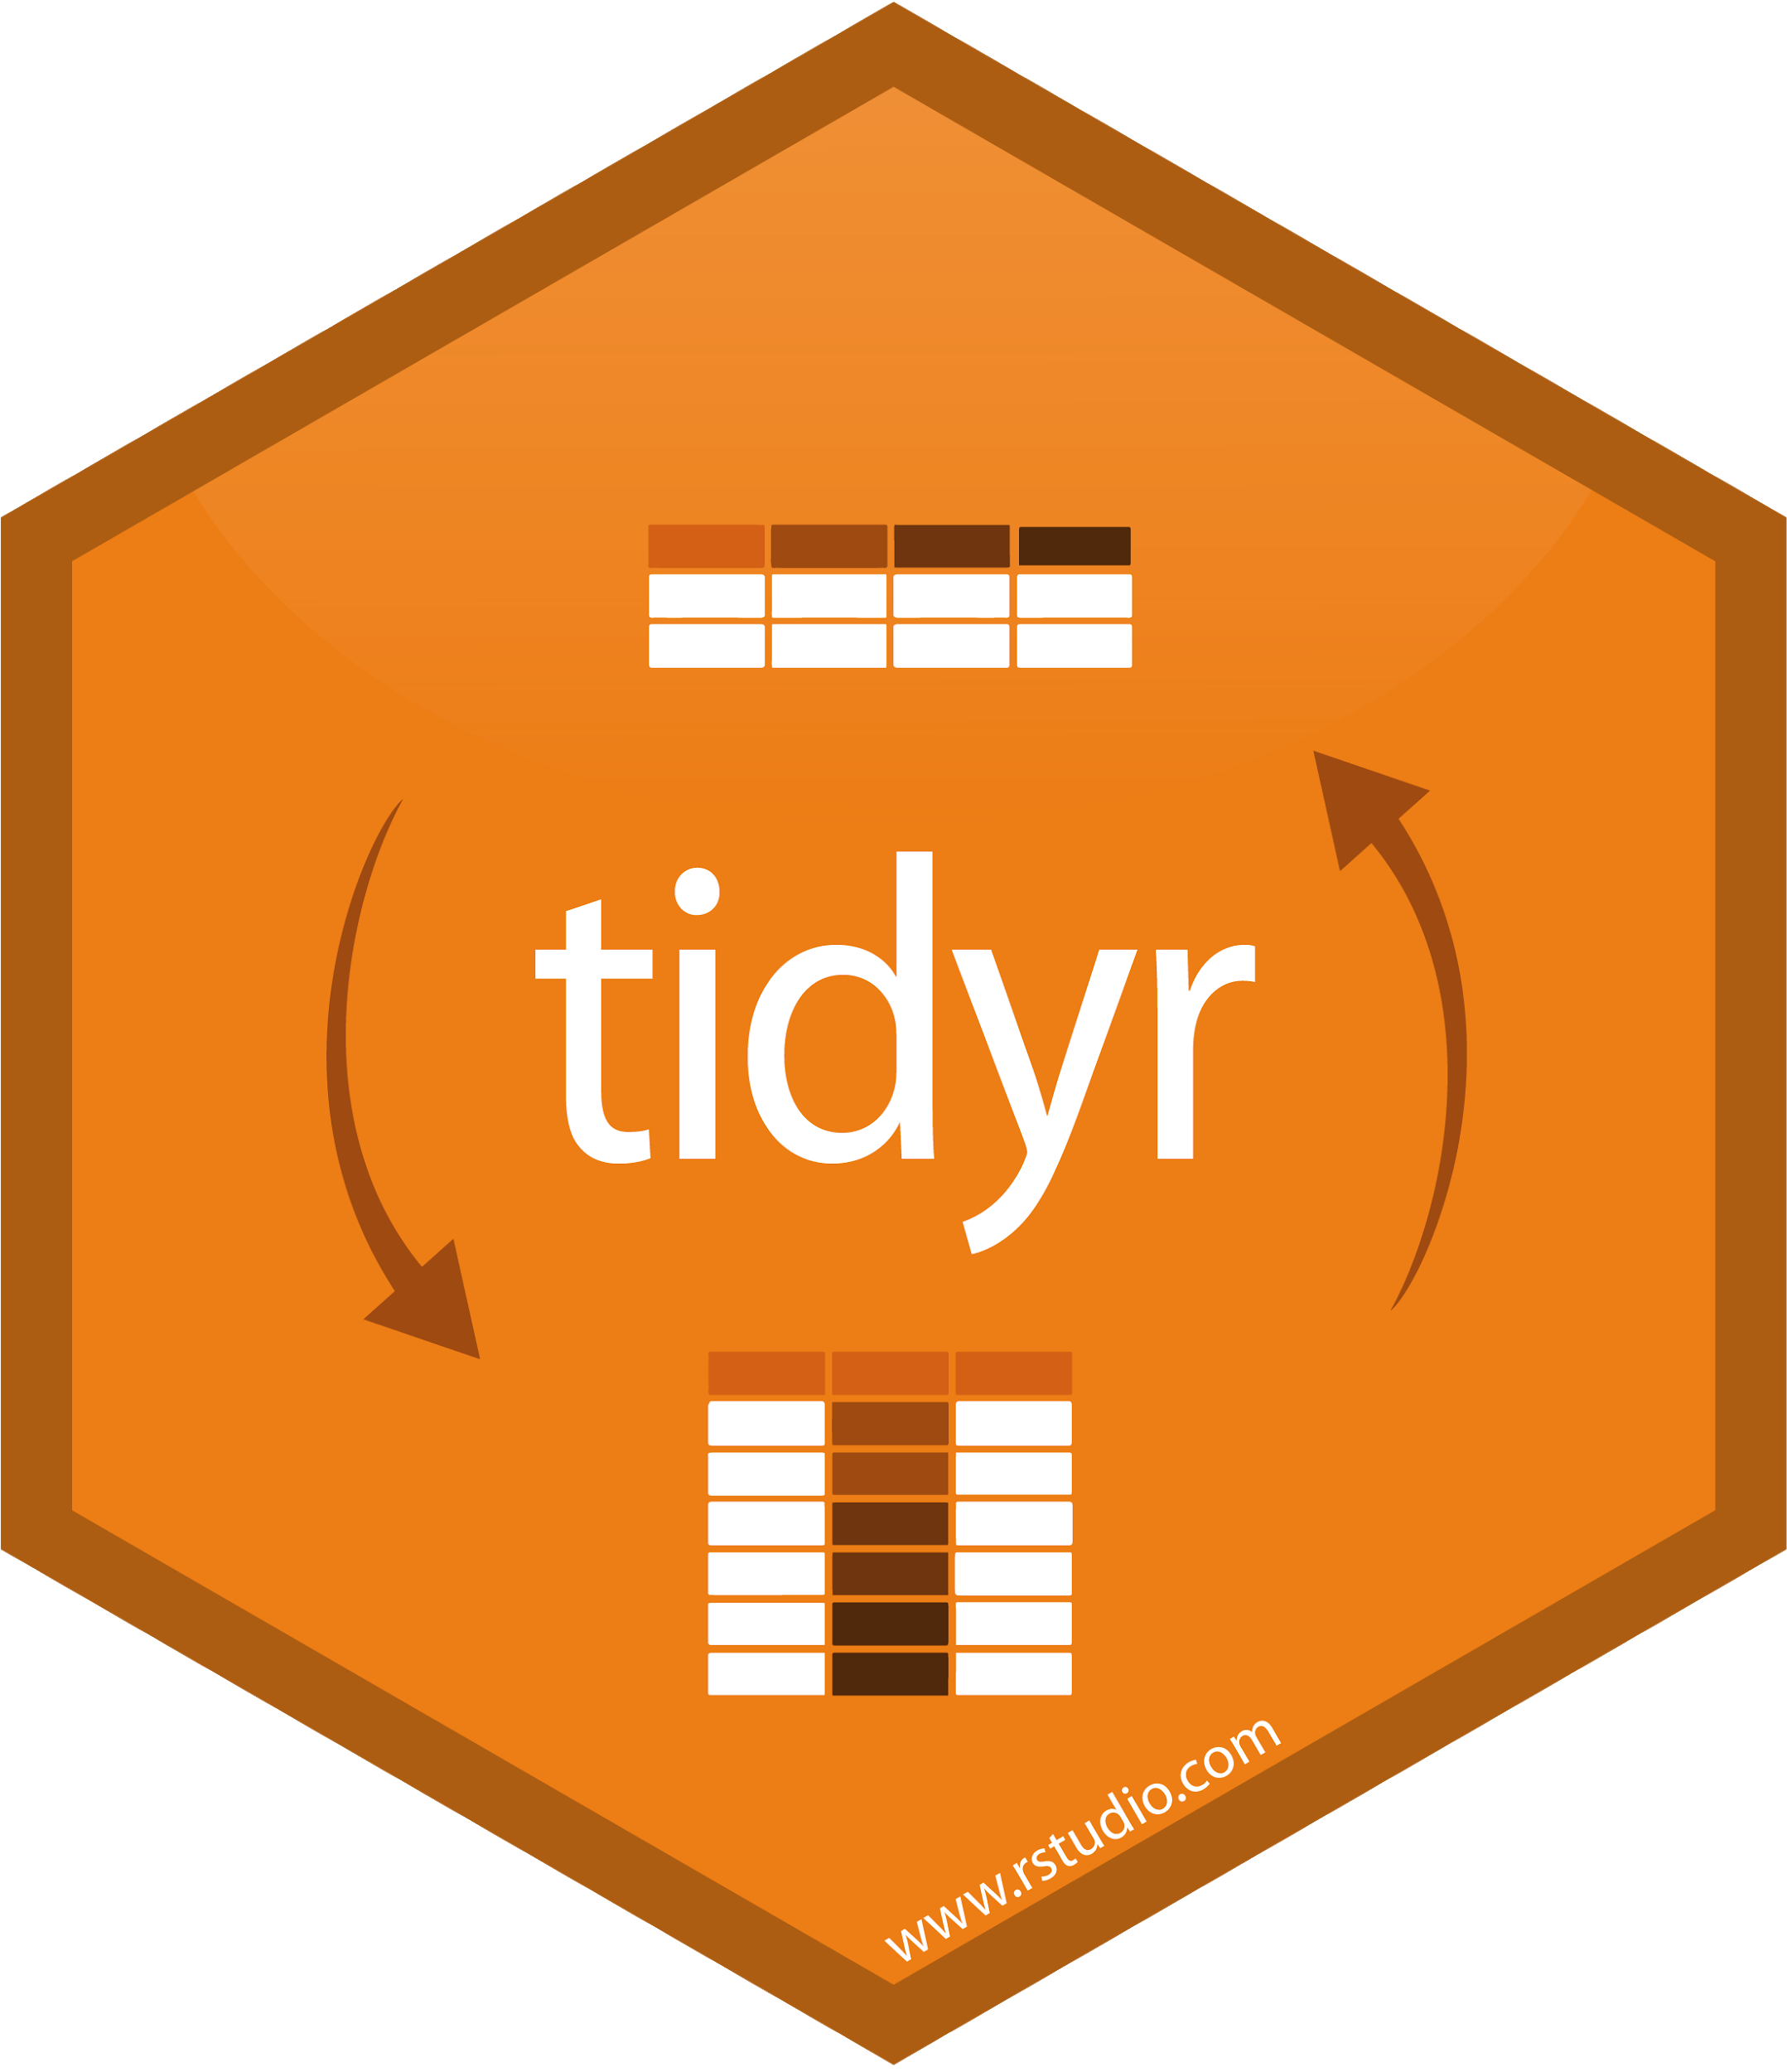
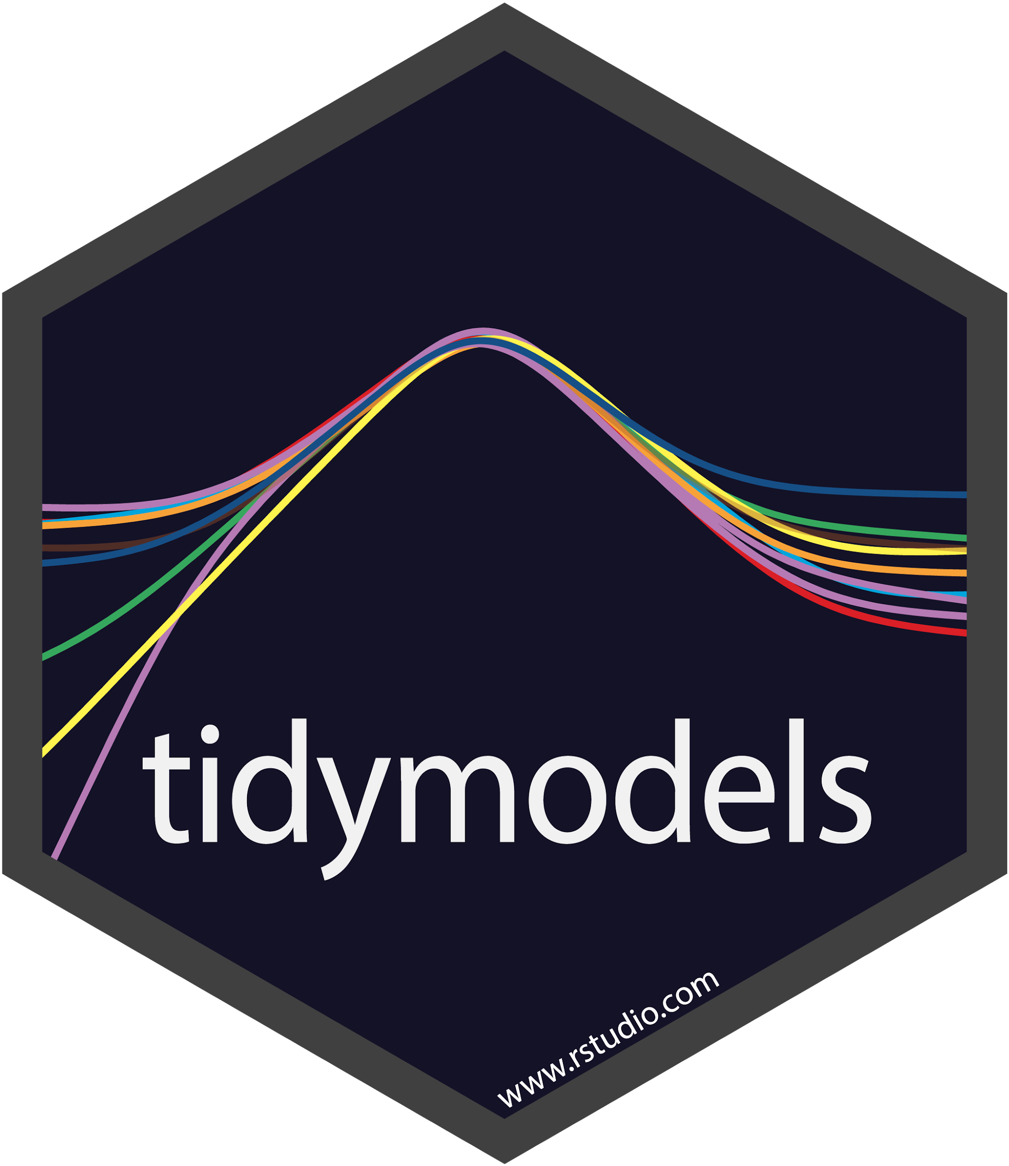





Tidyverse
First time install: install.packages("tidyverse")
Turn on package:
library(tidyverse)

Slide 46
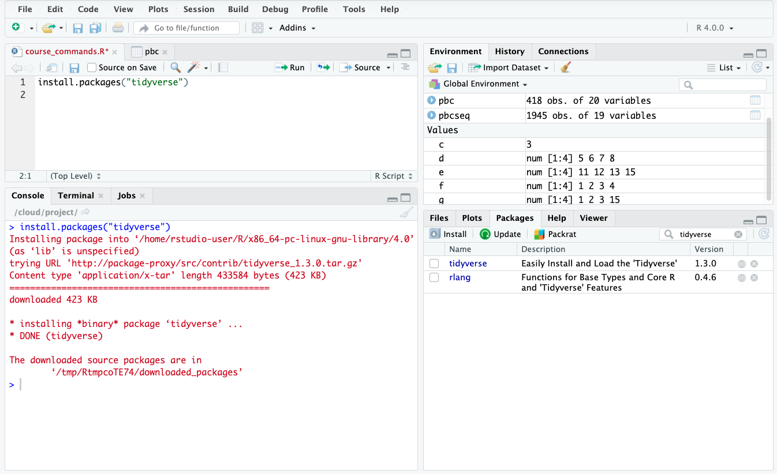
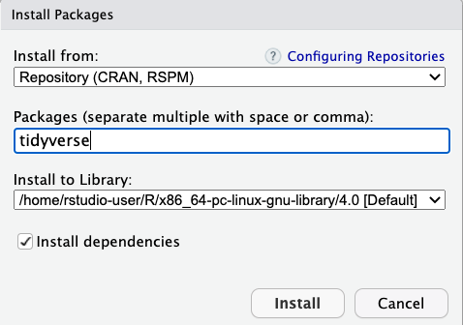
Install like this
Or like this

Slide 47
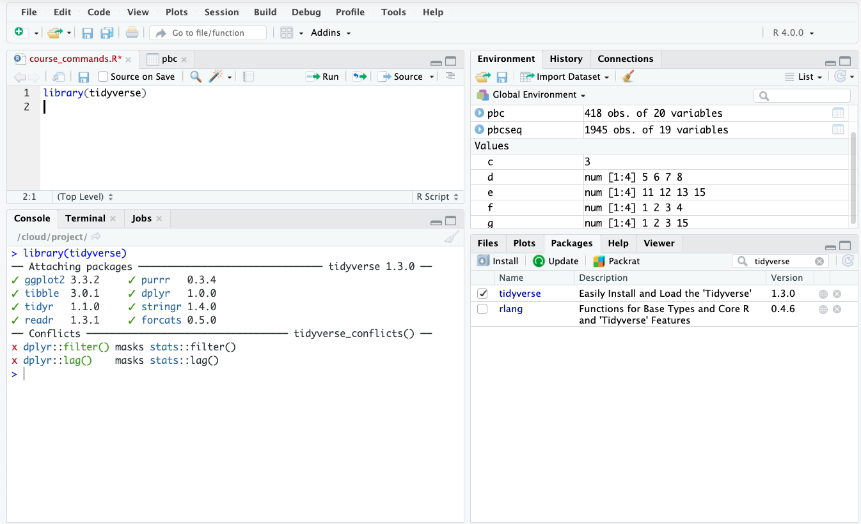
This
OR this
Notes:
install.packages("devtools")
devtools::install_github("tidyverse/tidyverse")

Slide 48
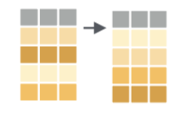
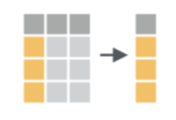
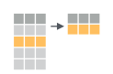
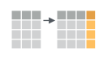
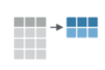
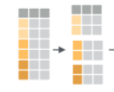
dplyr: Transform your data
arrange()
select()
filter()
mutate()
group_by()
summarize()
Basic structure:
functionName(data, specifics)
Example:
arrange(iris, Sepal.Length)
Notes:
pbc %>%
select(sort(names(.)))
pbc <- pbc %>% mutate(
age_bin = case_when(
age <= 45 ~ "Adult",
age >45 & age <= 60 ~ "Middle_aged",
age >60 ~ "Old"))
We can also use .after=age

Slide 49
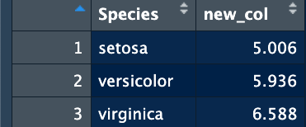
Pipes!
Keyboard Shortcut:
PC:Ctrl+Shift+M
Mac:Cmd+Shift+M
Pipes allow for sequential operations to be done on the same dataset
Output from one step is used as input to the next step
Avoids having to store all intermediate steps
Basic way to chain actions
group_by_species <- group_by(iris, Species)
iris_sep_len <-summarize(group_by_species, mean = mean(Sepal.Length))
View(iris_sep_len)
Pipe sequence (%>%)
iris_sep_len <- iris %>% group_by(Species) %>% summarize(new_col = mean(Sepal.Length))
View(iris_sep_len)
Notes:
summarise()` ungrouping output (override with `.groups` argument) This is just to tell you the data fed into the summary was grouped

Slide 50
Activity 3: Data Manipulation
3_Data_Manipulation.Rmd will explore the following data manipulations using the Tidyverse library:
Arrange
Select
Filter
Mutate
Summarize
GroupBy

Slide 51
Questions?
Activity 3 used the Tidyverse packages to explore data manipulation techniques
Process used the built-in Iris dataset
Final result was a grouped by aggregation

Slide 52
Concluding Remarks
This introduction to R introduced the basics of R, built-in datasets and package imports
Importing and using packages often prevents you from having to “reinvent the wheel”’
Statistical programming is greatly enhanced when combined with version control and data sharing techniques
Don’t be afraid of errors and be sure to explore the available resources for your work

Slide 53
This concludes the Intro to R
Thank you for your attention and participation!

Slide 54
Additional Materials
The following slides provide an overview of activities 4-6. Feel free to explore this topics on your own and use the code to learn more about R!
Activity 4: Data Import and export
Activity 5: Data Visualizations
Activity 6: Basic Data Analysis

Slide 55
Data Import and Export
Data comes in many formats
There are a variety of tools for importing and exporting data
R can handle data in csv, tab-delimited, excel formats, images and more

Slide 56
Save a table as a file
write.table(iris_mutate,”../data/iris_mutate.txt",row.names=F,sep="\t")
write.table is the command
iris_mutate is the data to be written
“../data/iris_mutate.txt” is the file path to write to
.. means go up a directory
Then go into the data directory and name the file iris_mutate.txt
row.names=F (False, do not write row names)
Sep = “\t” for tab delimited data

Slide 57
Read Data From Website
read_csv() and read_tsv() are special cases of the more general read_delim(). They're useful for reading the most common types of flat file data, comma separated values and tab separated values, respectively.
File can be a url where data is stored
Run `?read_tsv` for more help information

Slide 58
Activity 4: Data Import and Export
4_Data_Import_and_Export.Rmd will explore the following:
Save data as tab delimited text
Save data as a csv file
Load both tab delimited and csv files
Load data from a url

Slide 59
Visualizations for Today
Pie chart
Bar plot
Histogram
Density Plot
Scatter plot
Box Plot
Heat Map
Faceted plots (multiple plots in the same figure)

Slide 60
ggplot2: Visualize Data
Part of Tidyverse
Easy out of box formatting
Handles complex data quickly
Default options are aesthetically pleasing
Layering system = add complexity as you go
Automatic scaling generally works well
Great documentation and support

Slide 61
ggplot2: Visualize Data
What you need:
1. A data object
2. Aesthetic mappings (aes): how variables in the data are assigned to visual properties
x- and y-direction
shapes, colors, lines
3. A geometry object (geom): the type of plot
Basic structure:
ggplot(data, aes(x=variable)) + geom_type()
Example:
ggplot(iris, aes(x=Sepal.Length)) + geom_bar()

Slide 62
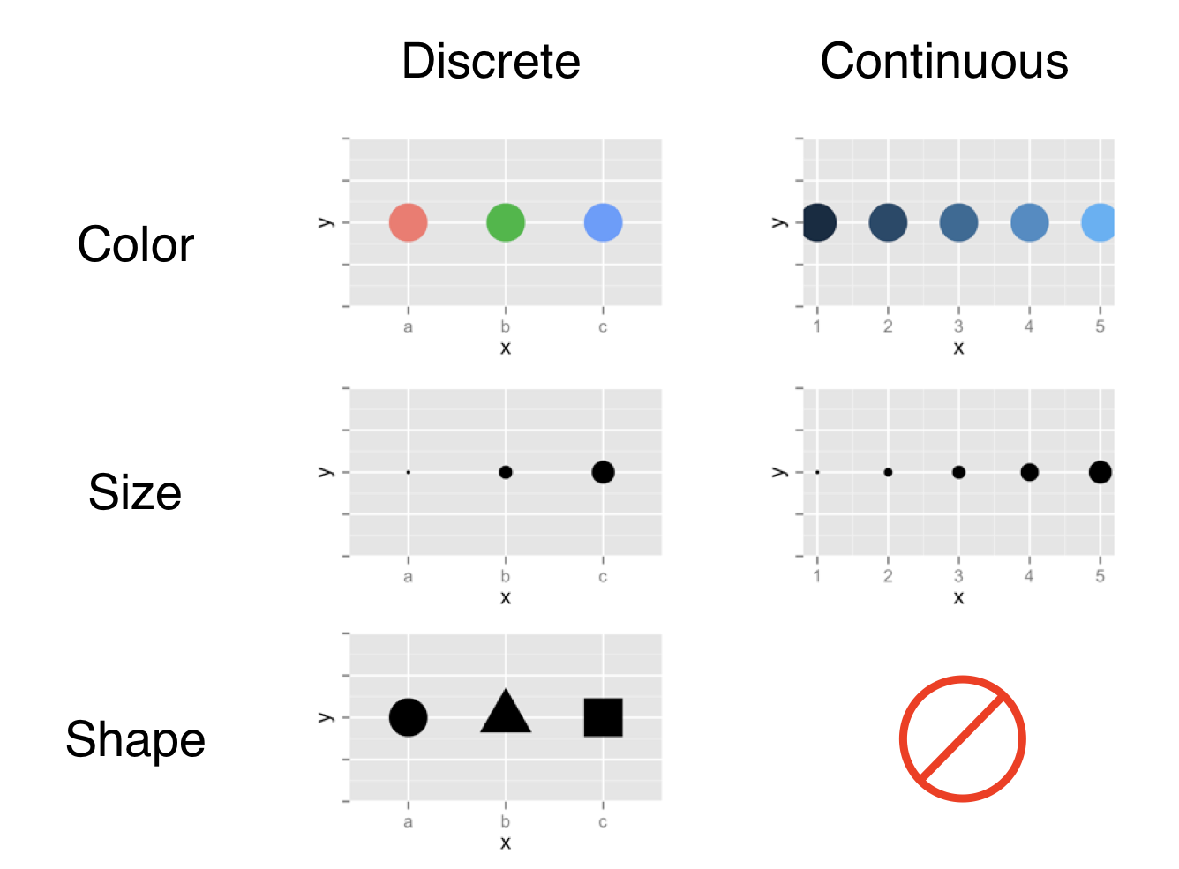
Aesthetic mapping options

Slide 63

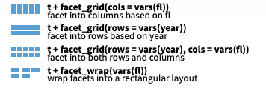
ggplot2: Faceting
Divide a plot into subplots based on one or more discrete variable
Can be used with a variety of plot types
There are a couple of facet flavors
We will use facet wrap

Slide 64
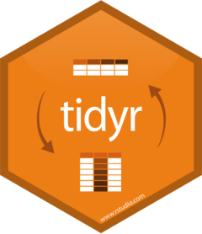
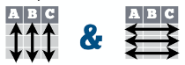
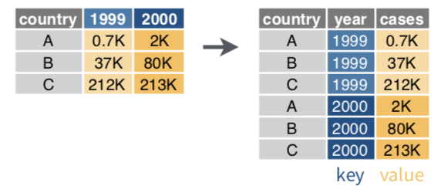
tidr: gather
Transform data from wide to long format
Typically, each variable is in its own column and each observation/case is its own row (wide format)
gather(data, key, value)
Moves column names into a key column, gathering the column values into a single value column (long format)
Notes:
Have note on opposite of gather

Slide 65
Activity 5: Data Visualization
5_Data_Visualization.Rmd explores plotting of various data types
Explore plotting and data visualizations

Slide 66
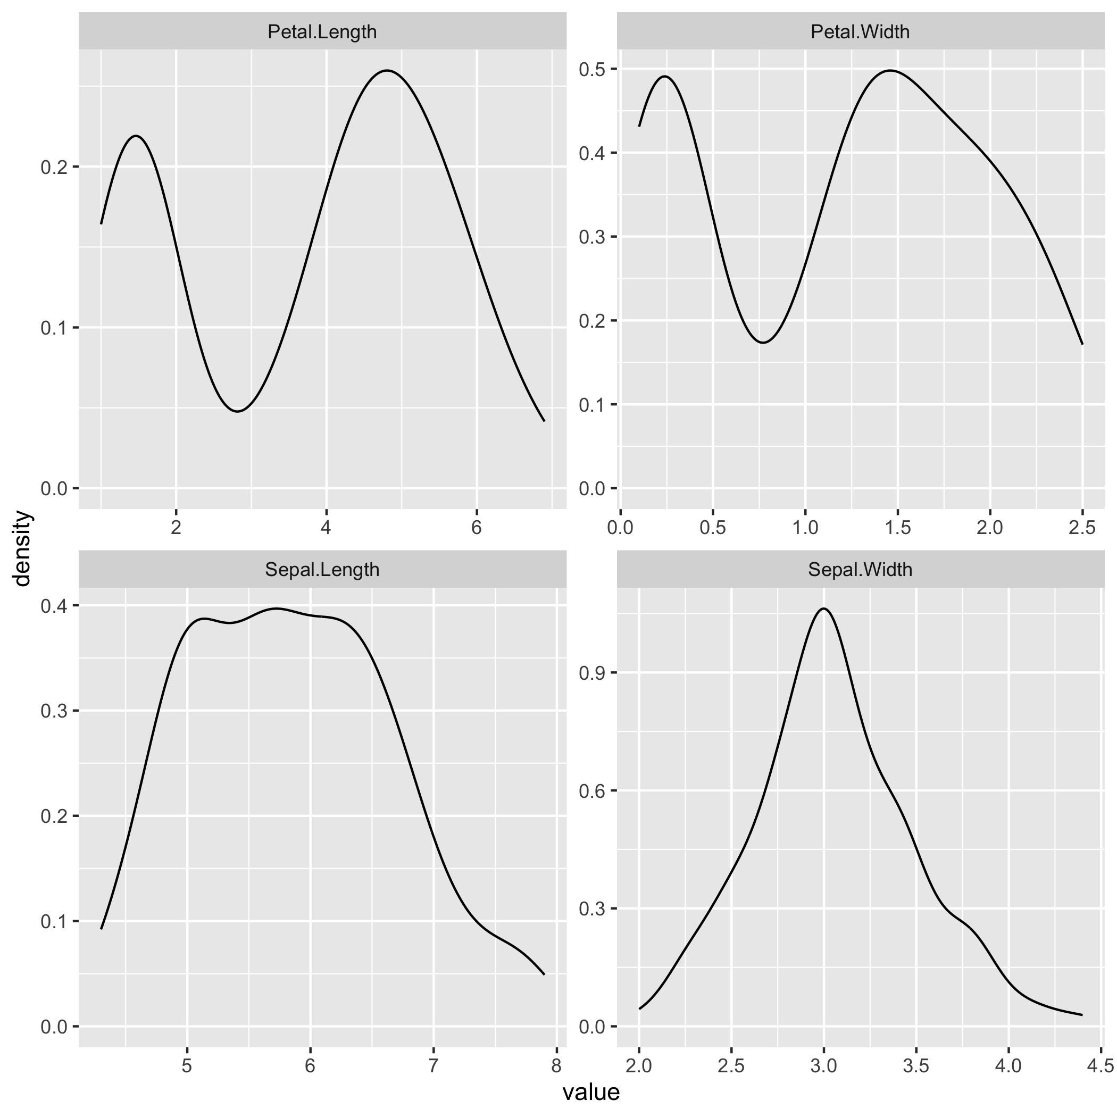
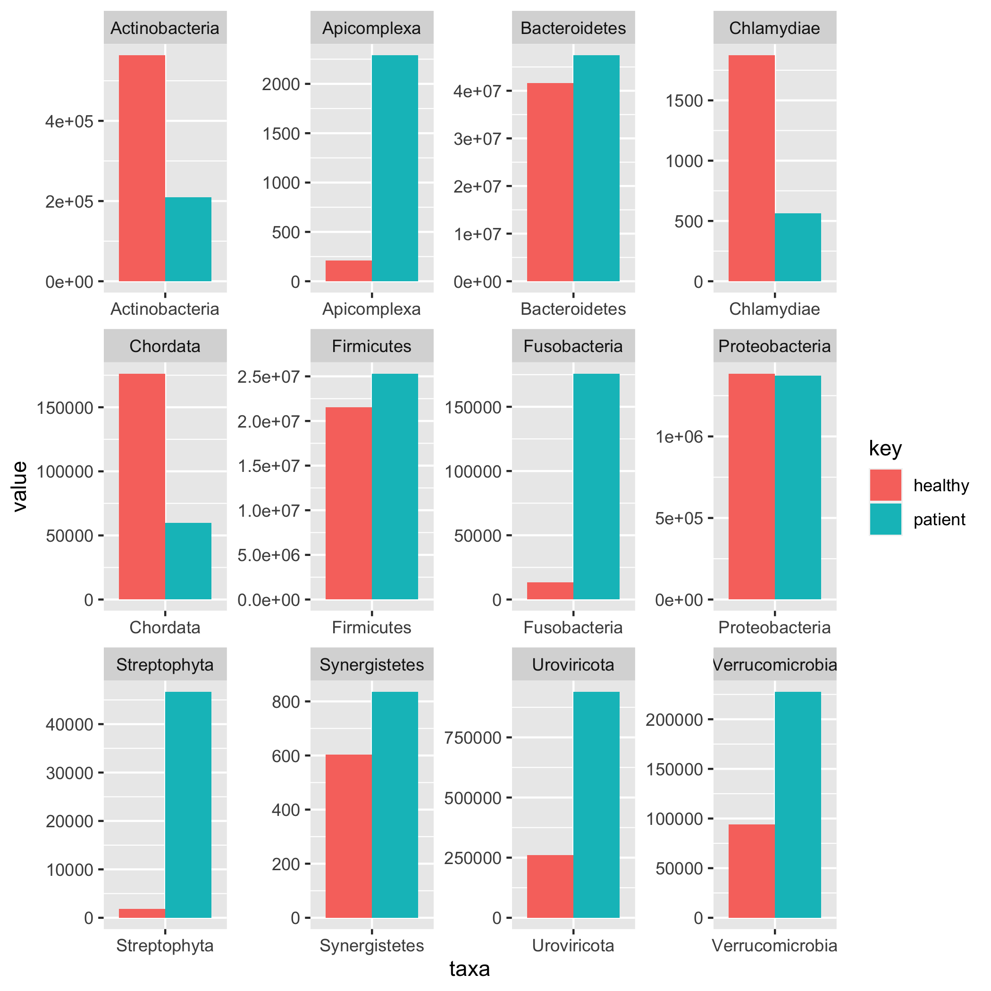
Questions on Basic Visualizations?

Slide 67
Data Analysis in R
Correlations
Pearson
t-tests
Single sample
Independent
Paired

Slide 68
Correlation
Measure of how well two variables hang together
Range from -1 to 1
1 is a perfect positive correlation
-1 is an inverse correlation

Slide 69
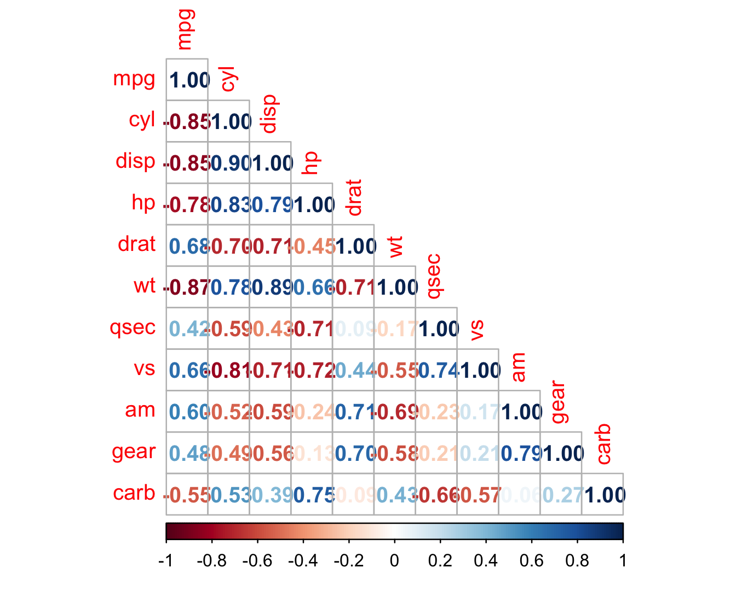
Correlation Matrix
Diagonal is all 1’s
Each variable is a perfect correlation with itself
Positive and negative correlations are color coded
Blue is positive
Red is negative
Strength is shown in darker colors

Slide 70
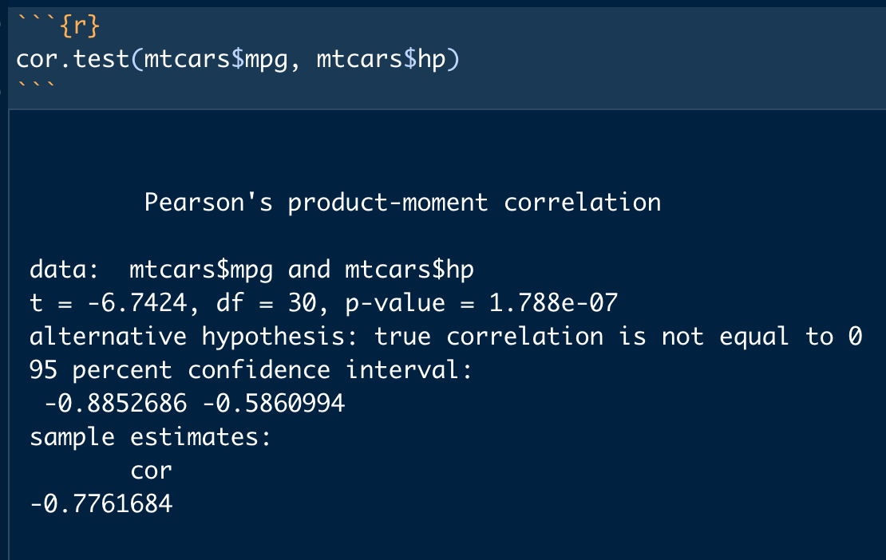
Correlation Test
Cor.test
P-value shows significance
Correlation coefficient is shown at bottom

Slide 71
t-tests
Single sample
Compares a sample to a known value (mu)
Independent
Compares two samples which are not related
Paired
Compares two samples which are related

Slide 72
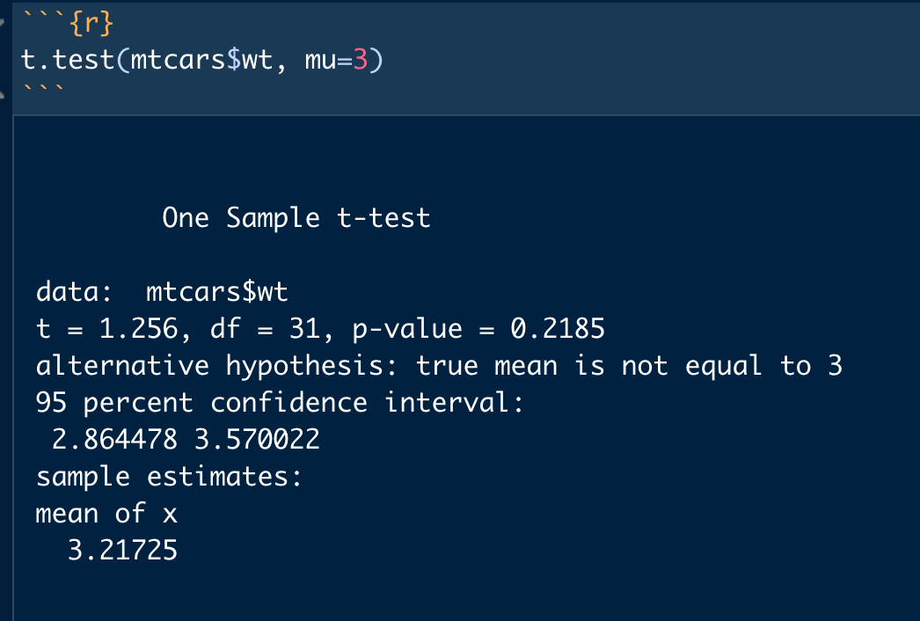
One Sample t-test
Compares a vector of data against a know value (mu)
p-value indicates significance
Mean of vector is shown at bottom

Slide 73
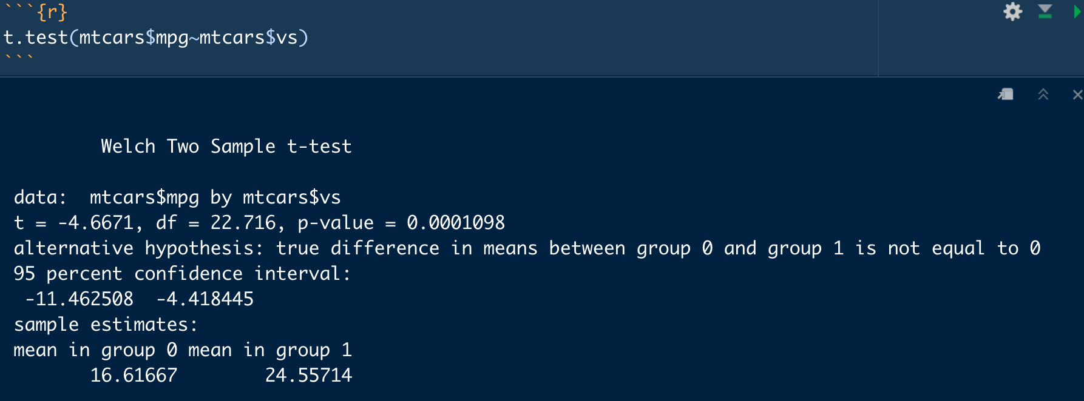
Two Sample Independent t-test
Compares two vectors of numeric data
Determines if means are different
p-value indicates significance
Means of each group displayed at bottom

Slide 74
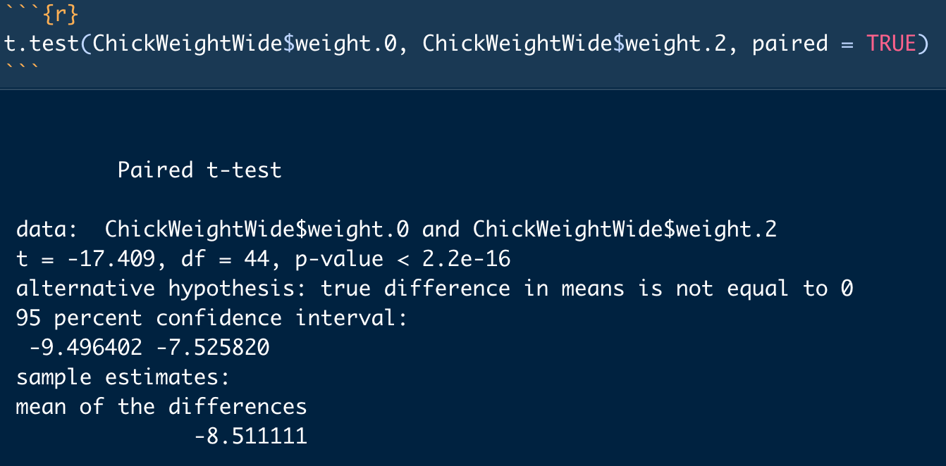
Paired-Samples t-test
Compares two related samples
p-value indicates significance
Average of the differences is shown at the bottom

Slide 75
Activity 6: Data Analysis in R
6_Data_Analysis.Rmd explores two basic analysis techniques
Correlations
t-tests
Many more analysis tools exist, this is only an introduction to the basics

